Slide 1
Basics of SMPS and UPS Systems
1. SMPS (Switched Mode Power Supply)
What it is: An electronic power supply that incorporates a switching regulator to convert electrical power efficiently from AC mains to regulated low-voltage DC outputs.
How it works: It rapidly switches the input voltage at a high frequency (typically tens to hundreds of kHz) using power transistors, enabling the use of much smaller, lighter transformers and achieving high conversion efficiencies (often 80–90%+).
Role in a PC: Steps down AC household voltage (220V–240V) and delivers clean, stable DC power rails (+12V, +5V, +3.3V) to internal components like the motherboard, processor, GPU, and storage drives.
2. UPS (Uninterruptible Power Supply)
What it is: An electrical apparatus that provides emergency backup power to loads when the input power source or mains power fails.
How it works: It bridges power disruptions using internal batteries. When mains power is normal, it charges the battery and conditions the power; when a blackout or significant voltage sag occurs, an inverter instantly switches to battery power.
Role: Protects sensitive electronics (like desktop computers and servers) from sudden shutdowns, preventing data corruption and hardware damage during power outages.
Part 2: Practical – Power Cables and Connectors Identification
ATX 24-Pin Power Connector: A large, multi-pin block supplying primary operating voltage to the motherboard.
ATX/EPS 4/8-Pin CPU Power Connector: A dedicated connector that supplies auxiliary 12V power directly to the processor socket on the motherboard.
SATA Power Connector: A flat, wide, thin connector used to power internal SATA solid-state drives (SSDs), hard disk drives (HDDs), and optical drives.
PCIe 6/8-Pin Power Connector: A specialized connector delivering high-current 12V power to dedicated graphics cards (GPUs).
Molex Connector: A legacy 4-pin cylindrical-pin connector used for older drives, fans, or accessory lighting hubs.

Slide 2
Here are 3 devices that use SMPS and 2 devices that use UPS, along with a brief explanation for each:
Devices Using SMPS (Switched Mode Power Supply)
Desktop PC / Workstation: Needs an SMPS to efficiently step down household AC voltage and convert it into multiple stable low-voltage DC rails (+12V, +5V, +3.3V) required by internal computer components.
CCTV Security Camera Setup: Uses an SMPS to provide continuous, regulated low-voltage DC power to keep security cameras running reliably around the clock.
LED TV / Monitor: Requires an SMPS to convert incoming AC mains power into clean direct current to power the display panel and internal logic boards.
Devices Using UPS (Uninterruptible Power Supply)
Desktop Gaming PC / Office Workstation: Needs a UPS to provide instant emergency battery backup during sudden power cuts, preventing data loss and hardware damage.
Wi-Fi Router / Optical Network Terminal (ONT): Uses a UPS to maintain uninterrupted internet connectivity and keep network devices powered on during power outages.

Slide 3
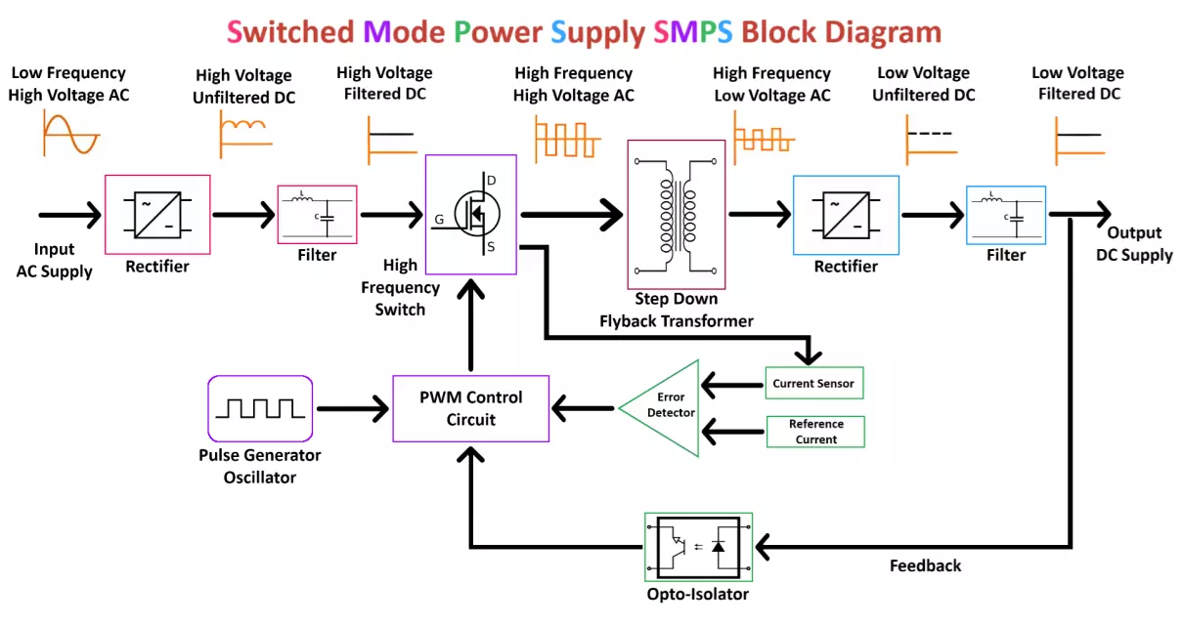

Slide 4
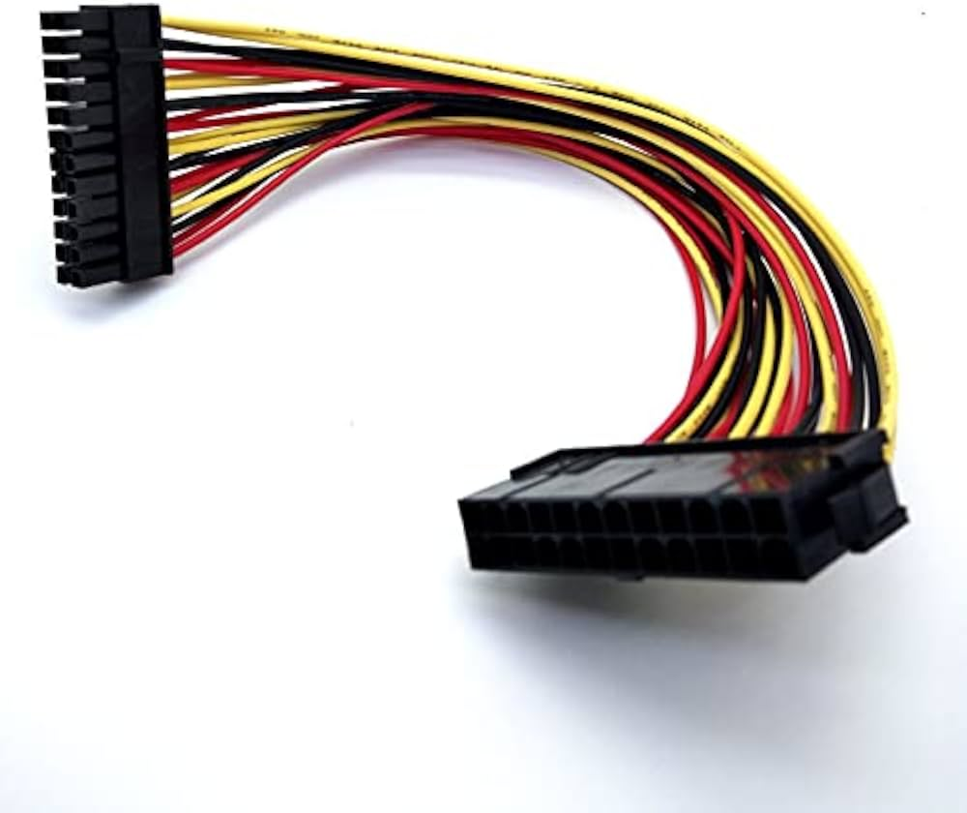
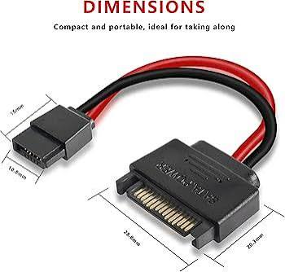
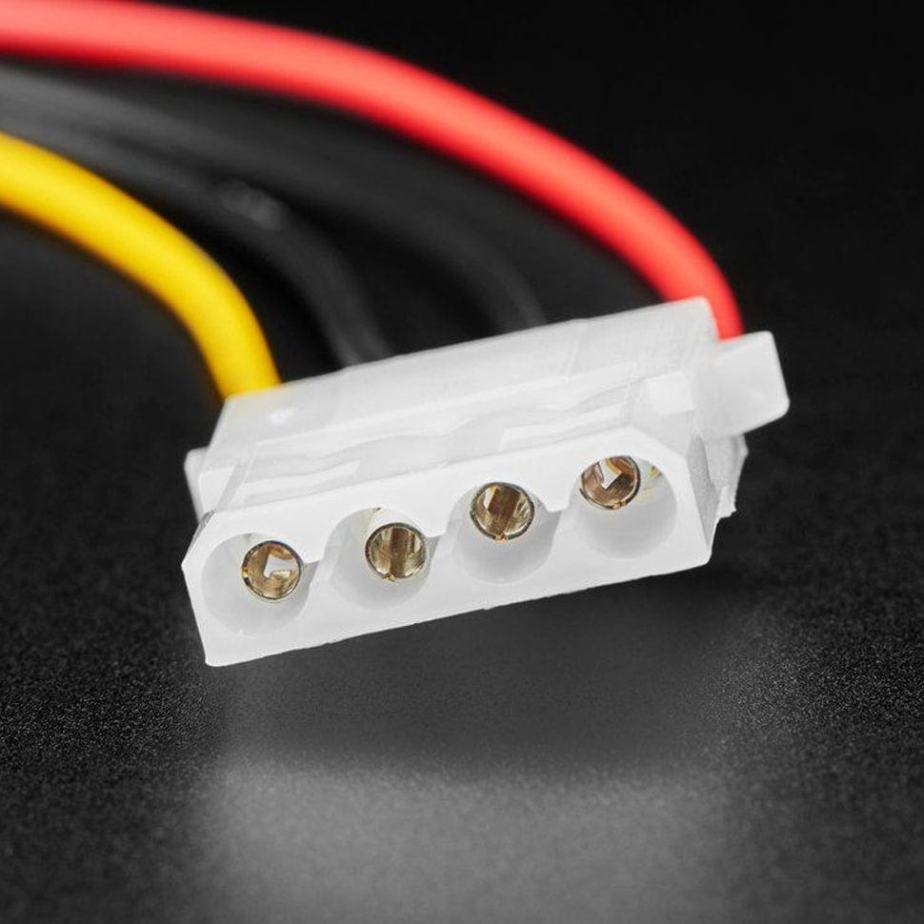
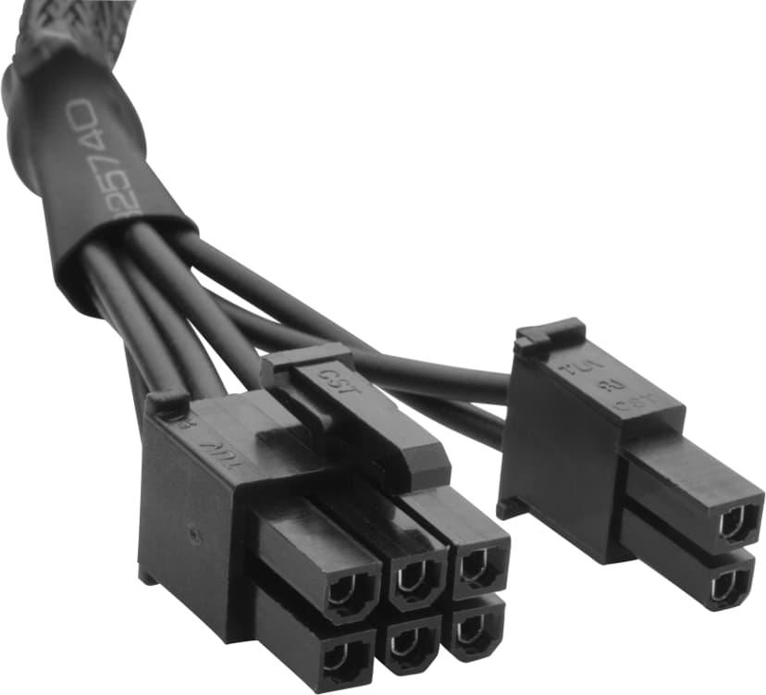
Power Connectors Guide
ATX 24-Pin Motherboard Connector:
  Devices Powered: The main motherboard circuit board, supplying primary power to the chipset, PCIe slots, and onboard peripherals.
  Safety Tip: Ensure the power supply is completely unplugged from the wall outlet before connecting or disconnecting, and press down fully until the plastic latch clicks into place.
SATA Power Connector:
  Devices Powered: Internal SATA solid-state drives (SSDs), mechanical hard drives (HDDs), and optical disc drives.
  Safety Tip: Handle the flat, wide connector carefully and push it straight in without bending the thin metal pins inside the header.
Molex Connector:
  Devices Powered: Legacy peripherals, older IDE hard drives, case cooling fans, or specialized LED lighting hubs.
  Safety Tip: These connectors fit very tightly; pull firmly on the plastic housing rather than yanking on the individual wires to prevent them from snapping.
PCIe 6/8-Pin Connector:
  Devices Powered: Dedicated graphics cards (GPUs).
  Safety Tip: Never force a PCIe power connector into a CPU 8-pin socket (they look similar but have different pin layouts), and always squeeze the release clip when unplugging.

Slide 5
. Step-by-Step Guide: Connecting SMPS to PC Components
Mount the SMPS: Secure the power supply unit inside the bottom or top chamber of the PC case using its mounting screws.
  Verification: Ensure the unit is firmly screwed in and does not wobble.
Connect the 24-Pin ATX Main Power: Take the thick 24-pin cable from the SMPS and plug it firmly into the matching 24-pin power slot on the right edge of the motherboard.
  Verification: Check that the plastic security latch on the connector clicks securely into the motherboard socket.
Connect the CPU Power (EPS 4/8-pin): Route the 4-pin or 8-pin CPU power cable from the SMPS to the top-left corner of the motherboard near the processor socket.
  Verification: Ensure the clip locks into place to supply stable power to the CPU.
Connect the Graphics Card (PCIe 6/8-pin): Plug the required 6-pin or 8-pin PCIe power cables from the SMPS directly into the power sockets on your dedicated graphics card.
  Verification: Verify that the small locking tab clicks and any built-in LED indicators on the GPU glow to show proper power delivery.
Connect Storage Drives (SATA Power): Plug the flat SATA power cables from the SMPS into the power ports on your SSDs or hard drives

